Slide 1
NORTHERN LEAF BLIGHT DISEASE DETECTION USING IMAGE CLASSIFICATION
Imelda Masika
Sheila Kamanzi
Robin Mutai
Muthoni Kahura
Bryan Okwach
Felix Awino
GROUP IX

Slide 2
Business Problem
The project leverages machine learning and computer vision techniques to create an automated system for Northern Leaf Blight (NLB) disease detection, enabling early intervention and improved crop management.

Slide 3

Project Objectives
01
Develop an automated NLB disease detection system using image classification techniques.
02
Enable early and accurate identification of NLB-infected maize plants.
03
Create a user-friendly interface for farmers to access and utilize the system in the field
04
Reduce the reliance on manual inspection methods, saving time and resources for farmers

Slide 4
Stakeholders
01
Farmers- Especially large scale maize farmer
02
Government Agencies such as KALRO that specializes on plant disease control.
03
Research Institutions- -

Slide 5
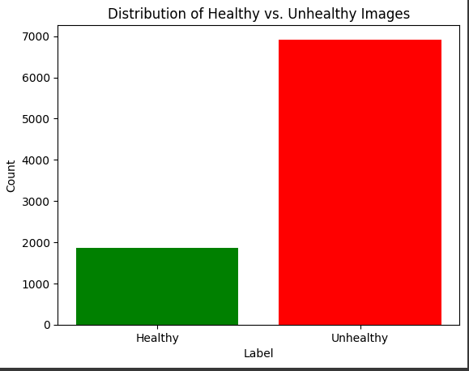
Data Imbalance
Significant Data Imbalance in the dataset

Slide 6
Data Preprocessing
Data Augmentation: Resizing, rotation, zooming and flipping of images to size 128 by 128.
Organizing Data for Model Training into: Training, Validation, Testing sets
Categorizing Images into healthy/unhealthy for Structured Model Training
Verifying the Count of Processed Images.
Validating Uniqueness in Processed Images.
Establishing Data Directories
Inspecting Processed Image Attributes Post-processing
Visualizing Class Distribution in Data Subsets

Slide 7
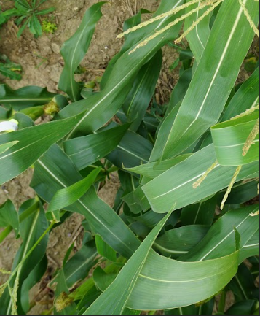
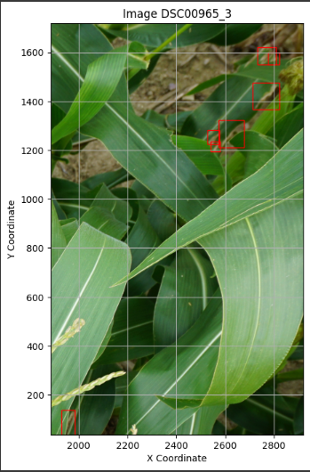
Annotations on a Sample Image
Raw Image sample as captured
Image sample with Annotation
60%
90%
80%
70%

Slide 8
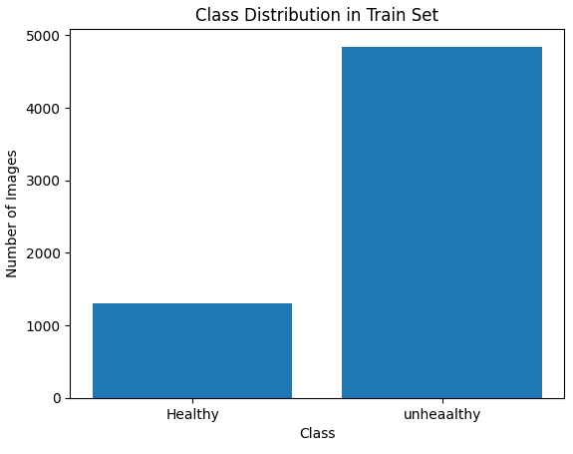
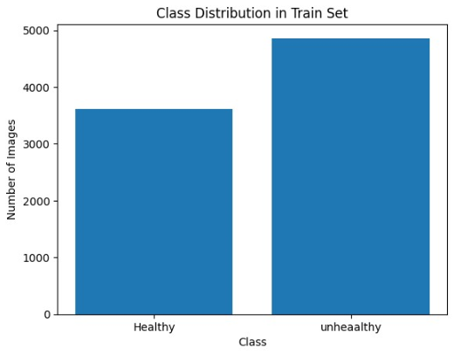
Exploratory Data Analysis
Class Distribution in train set with data imbalance
Class Distribution after resolving data imbalance
60%
90%
80%
70%

Slide 9
Handling Data Imbalance
01
Random data selection with equal data quantities
02
Assigning class weights by ratio of class data imbalance
03
Oversampling and undersampling using SMOTE technique.

Slide 10
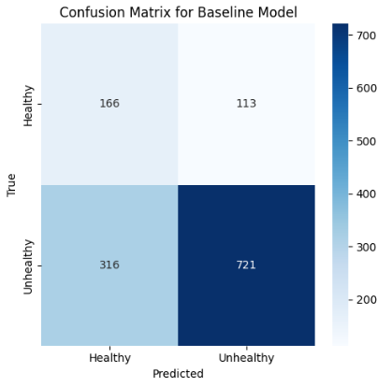
Baseline Model CNN
Baseline Model Confusion Matrix
CNNs are particularly suited for image recognition tasks
The model's architecture involves several layers.
60%
90%
The model is compiled with the categorical cross-entropy loss function
The labels are also one-hot encoded transforming them into a format suitable for classification tasks
80%
70%

Slide 11
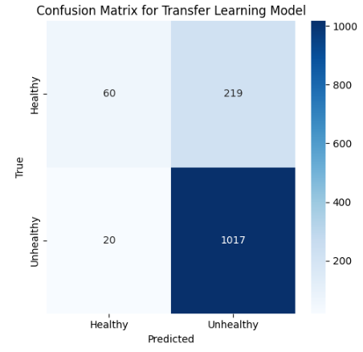
Transfer Learning Model VGG16
VGG16 Model Confusion Matrix
We used the VGG16 model, which is effective in image recognition.
We set up data augmentation to artificially expand our dataset.
60%
90%
We Loaded and Customized VGG16 Model
The labels are also one-hot encoded transforming them into a format suitable for classification tasks
80%
70%

Slide 12
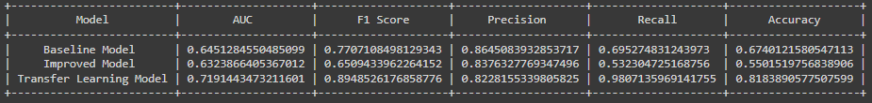
Evaluation Metrics-Multiple Models
The Transfer Learning Model achieved the highest AUC
F1 Score, the Transfer Learning Model also outperformed the other models
Transfer Learning Model demonstrated the highest recall.
Transfer Learning Model appears to be the strongest performer overall

Slide 13
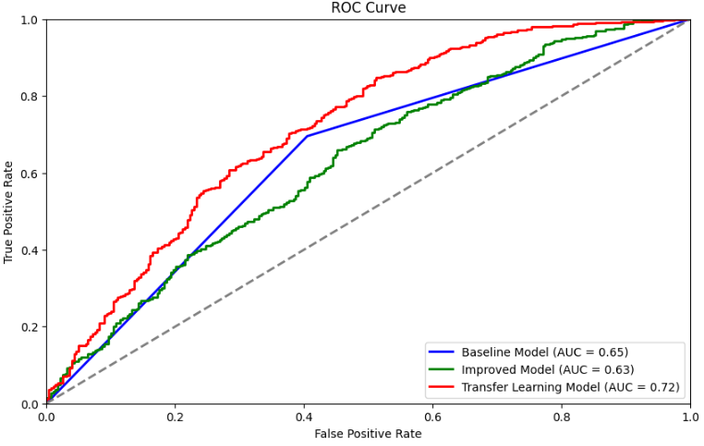
ROC CURVE-Multiple Models

Slide 14
Conclusion
The transfer learning model (VGG16) significantly outperformed the other models in terms of accuracy, AUC, F1 Score, and recall. This underscores the effectiveness of leveraging pre-trained networks, particularly for tasks where the dataset features complex, intricate patterns that a model trained from scratch might not recognize efficiently

Slide 15
Recommendations
The model should be used to aid early disease detection and prevention once NLB disease is detected in the plant photos
The Government should invest in refining and improving the model and make it accessible to the farmers.
The model should be used to give recommendations for appropriate NLB disease control method based on the age and the spread of the disease.
Farmers are advised to keep a database of photos throughout the planting season to be used for future model training and improvement.
Government of Kenya to improve on data collection, storage and available to allow for better training of image prediction models and for future research purposes

Slide 16
Next Steps
Experiment with Advanced Models: Explore more complex architectures to see if these can further improve accuracy and generalization
Invest in Data Quality: Higher-quality data or more diverse datasets to provide the models with a richer learning environment.
Feedback Loop: Implement a system for continuous feedback and learning.
Operationalization This involves setting up an infrastructure that can handle model requests, ensuring security protocols are followed, and establishing a monitoring system for model performance.
User Testing: extensive user testing before full deployment to gather feedback on model performance in real-world scenarios. This helps in identifying unforeseen issues and areas for improvement.

Slide 17
THANK YOU

